Slide 1



UNIT 6: Around the world
A beautiful planet

Slide 2
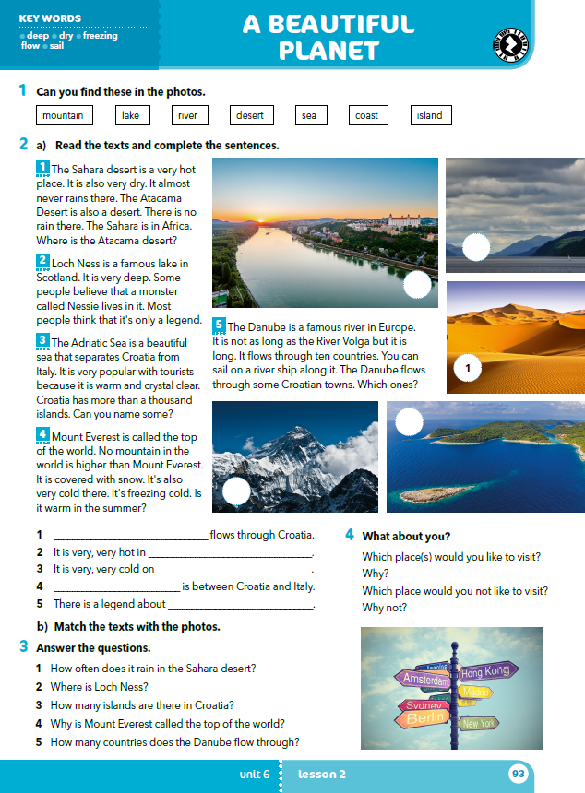
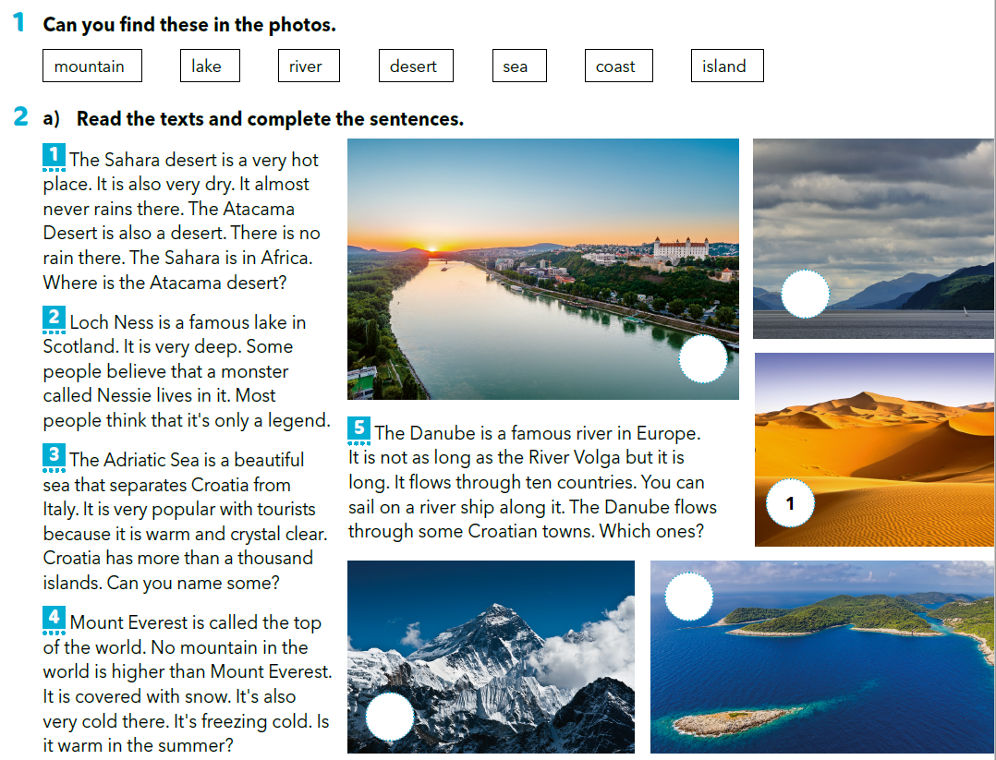
What colours can you see?

Slide 3
Tranaslate
Can you name things in the photos? Use the words from task 1.
planina
jezero
rijeka
pustinja
more
obala
otok

Slide 4
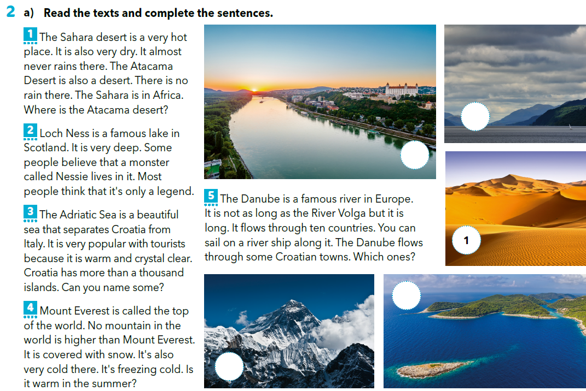
2
5
3
4

Slide 5
Tranaslate
dry = flow through =
deep = the Danube =
freezing = the Adriatic Sea =
sail =
suh
protjecati kroz
dubok
Dunav
leden, koji se smrzava
Jadransko more
ploviti
Read the texts aloud.
Read it in different voices (e.g. first read it very quietly, then very loudly.
After that read it as if you were chewing a gum and as if you were sneezing).

Slide 6
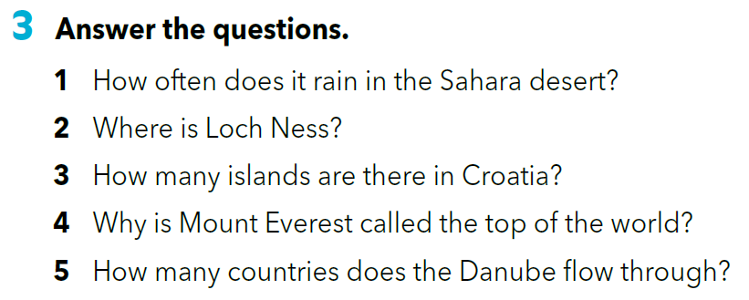
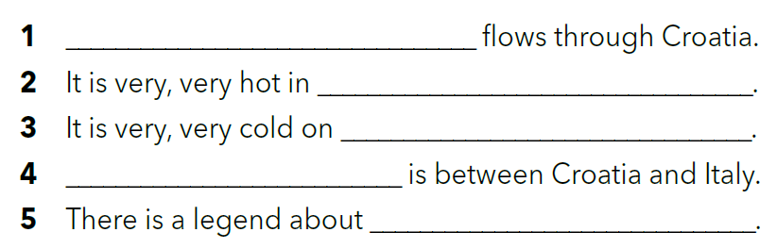
Complete the sentences under the texts.
Answer the questions in full sentences.
The Danube
the Sahara
Mount Everest
The Adriatic Sea
Loch Ness
1 It almost never rains in the Sahara desert.
2 Loch Ness is in Scotland.
3 There are more than a thousand islands in Croatia.
4 No mountain in the world is higher than Mount Everest.
5 The Danube flows through ten countries.

Slide 7
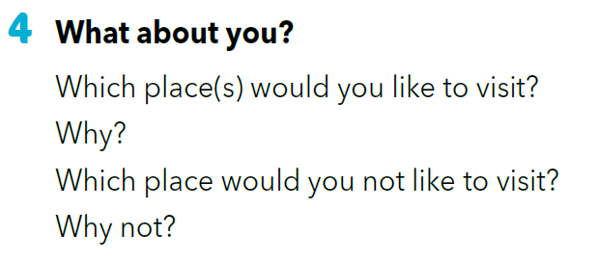
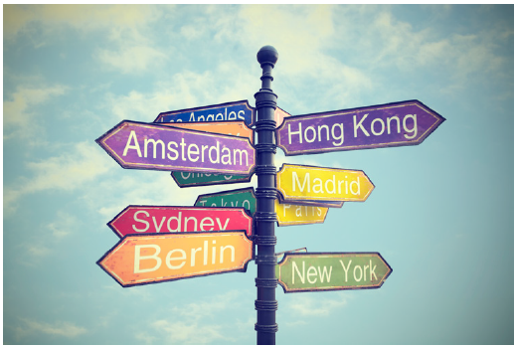
Discuss your answers in pairs and after that with the rest of your classmates.

Slide 8
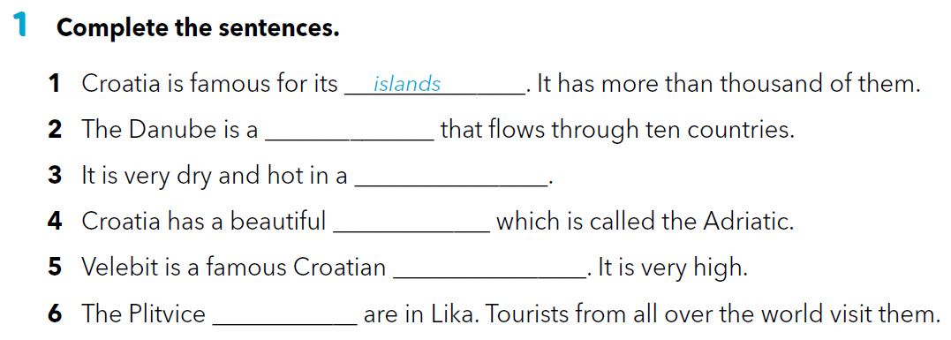
Read the texts once again and try and memorize as much information as you can.
Workbook p. 62
river
desert
sea
mountain
lakes

Slide 9
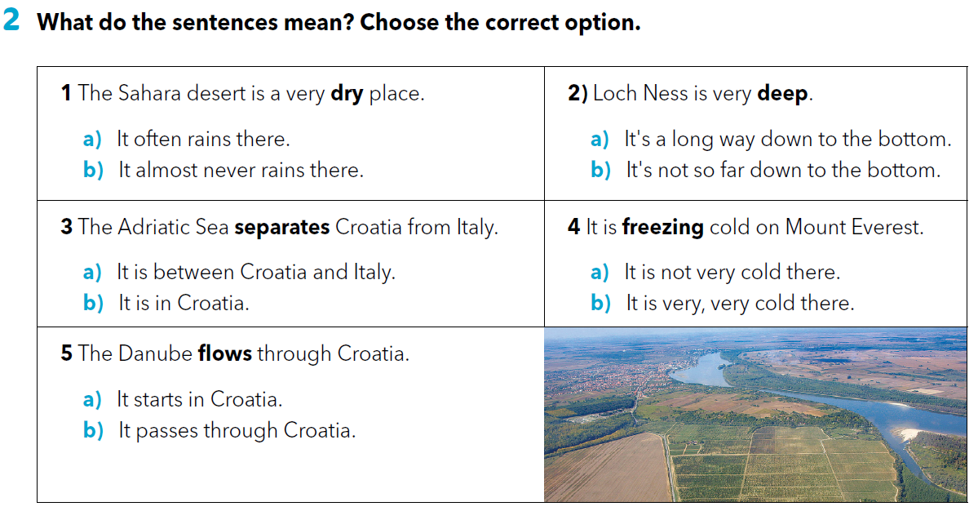

Slide 10
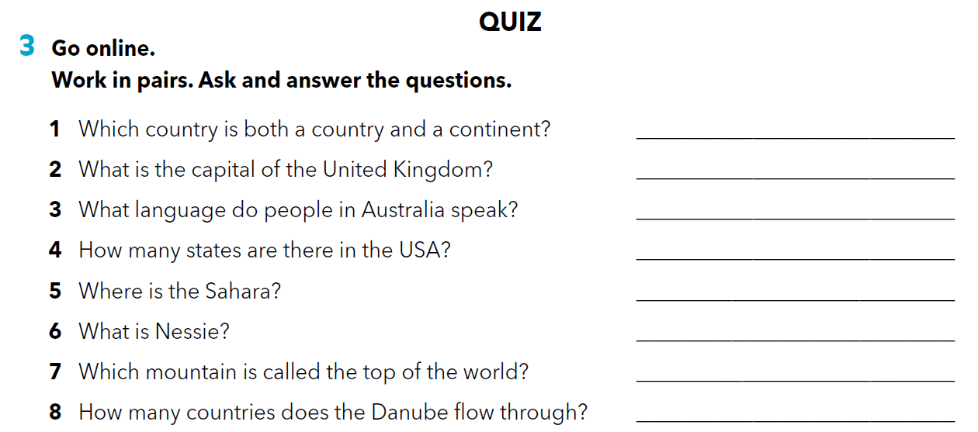
Australia.
London.
English.
50.
Africa.
A monster.
Mount Everest.
Ten.

Slide 11
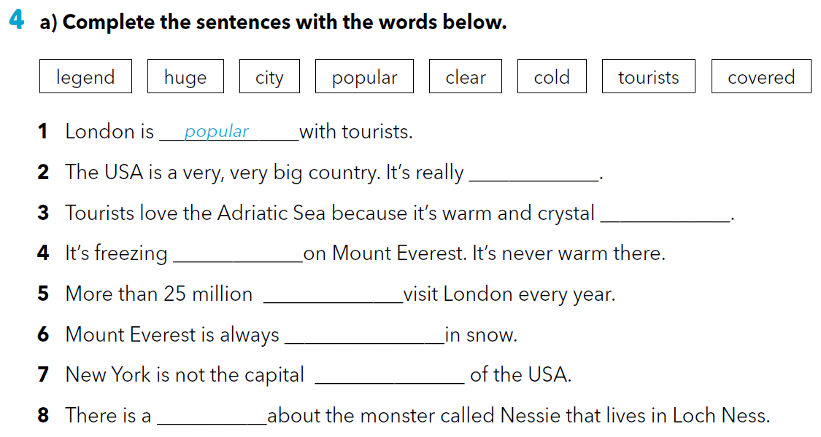
huge
clear
cold
tourists
covered
city
legend

Slide 12
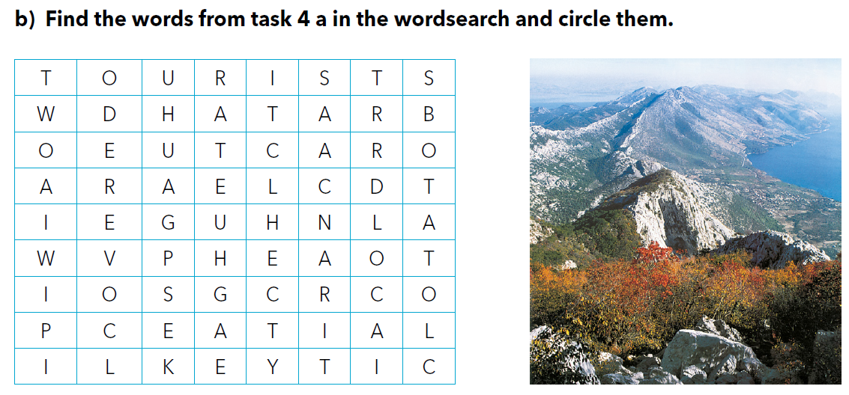

Slide 13
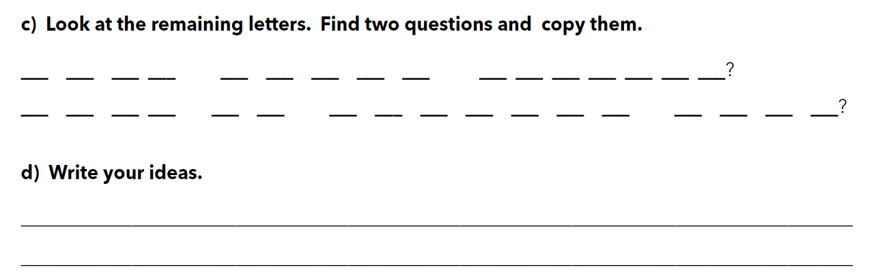
W H A T A B O U T C R O A T I A
W H A T I S C R O A T I A L I K E

Slide 14

LET’S REVISE!
Revise the vocabulary
https://wordwall.net/play/260/237/270
SELF CHECK
https://www.e-sfera.hr/dodatni-digitalni-sadrzaji/2d645042-1751-4ee5-b7eb-74b1e6697178/
.

Slide 15
LEARN MORE.
https://www.e-sfera.hr/dodatni-digitalni-sadrzaji/2d645042-1751-4ee5-b7eb-74b1e6697178/
More wonderful places

